Slide 1
Analysis of Algorithms Week 3

Slide 2
Topics
Definition
Algorithm
Time complexity
Space complexity
Common time complexities
O(1) - Constant time
O(log n) - Logarithmic time
O(n) - Linear time
O(n log n) - Linearithmic time
O(n^2) - Quadratic time
Case Studies
Computing time complexity
Max subsequence sum

Slide 3
Introduction
An algorithm is a clearly specified set of simple instructions to be followed to solve a problem.
An algorithm that takes days to solve a problem is useless
An algorithm that takes gigabytes of space to solve a problem is also useless

Slide 4
What to analyze?
Time it takes to complete the processing
Space it takes to complete the processing
What contributes to the time it takes?
Computer processing power
Computer memory
Data set size
Differ from computer to computer

Slide 5
Importance of analysis
Efficiency and Performance Optimization
Algorithm Selection
Scalability
Resource Management
Benchmarking and Comparison

Slide 6
Big O notation
Big O notation is a mathematical notation used to describe the upper bound or worst-case behavior of an algorithm in terms of its time or space complexity.
It provides an asymptotic upper limit on the growth rate of the algorithm's resource usage.
In other words, for a given input size n greater than some n₀ and a constant c, the run-time of that algorithm will never be larger than c × f(n).
Given functions f(n) and g(n), we say that f(n) is O(g(n)) if there are positive constants c and n₀ such that
f(n) ≤ cg(n) for n ≥ n₀

Slide 7
Examples
Example: 2n + 10 is O(n)
2n + 10 ≤ cn
(c − 2) n ≥ 10
n ≥ 10/(c − 2)
Pick c = 3 and n₀ = 10
Example: the function n² is not O(n)
n² ≤ cn
n ≤ c
The above inequality cannot be satisfied since c must be a constant

Slide 8
More examples
7n-2 is O(n)
need c > 0 and n₀ ≥ 1 such that 7n-2 ≤ c•n for n ≥ n₀
this is true for c = 7 and n₀ = 1
3 log n + 5 is O(log n)
need c > 0 and n₀ ≥ 1 such that 3 log n + 5 ≤ c•log n for n ≥ n₀
this is true for c = 8 and n₀ = 2

Slide 9
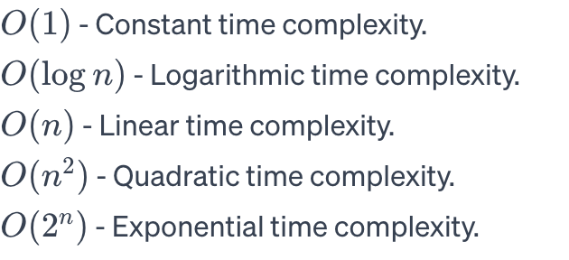
Examples

Slide 10
Big Omega and Theta
Big Omega (Ω) notation represents the lower bound or best-case behavior of an algorithm.
Theta (Θ) notation represents both the upper and lower bounds, indicating a tight bound on the algorithm's complexity.
Big Omega (Ω) is used to describe the best-case scenario.
Theta (Θ) is used when the best and worst-case complexities are the same.

Slide 11
Formally
big-Omega
f(n) is Ω(g(n)) if there is a constant c > 0
and an integer constant n₀ ≥ 1 such that
f(n) ≥ c•g(n) for n ≥ n₀
big-Theta
f(n) is Θ(g(n)) if there are constants c’ > 0 and c’’ > 0 and an integer constant n₀ ≥ 1 such that c’•g(n) ≤ f(n) ≤ c’’•g(n) for n ≥ n₀

Slide 12
Big-Oh
f(n) is O(g(n)) if f(n) is asymptotically less than or equal to g(n)
big-Omega
f(n) is Ω(g(n)) if f(n) is asymptotically greater than or equal to g(n)
big-Theta
f(n) is Θ(g(n)) if f(n) is asymptotically equal to g(n)

Slide 13
Best, Worst, and Average-Case Analysis
Best-Case Analysis: Describes the lower bound or the minimum amount of resource an algorithm requires.
Worst-Case Analysis: Describes the upper bound or the maximum amount of resource an algorithm requires.
Average-Case Analysis: Describes the expected performance of an algorithm on average.

Slide 14
Space complexity
Space complexity is a measure of the amount of memory or space required by an algorithm to solve a computational problem.
It is expressed in terms of the growth rate of space usage concerning the input size.

Slide 15
Auxiliary Space vs. Space Complexity
Space Complexity: The total space used by an algorithm, including both auxiliary space and input space.
Auxiliary Space: The extra space used by an algorithm, excluding the space needed for the input.

Slide 16
Space vs. Time complexity
Like time complexity, space complexity has concepts of Big O, Big Omega, and Theta notations.
The choice between different algorithms may involve considering their space complexity, especially in memory-constrained environments.
Trade-offs
There is often a trade-off between time and space complexity.
More memory-efficient algorithms might have higher time complexity, and vice versa.
The goal is to strike a balance based on the specific requirements of the problem and the constraints of the system.

Slide 17
Optimize space usage
Techniques such as data compression, dynamic programming, and efficient data structures can be employed to optimize space usage.
Designing algorithms with lower space complexity is particularly important in scenarios with limited memory resources.
Space complexity is a critical consideration in modern computing environments, especially in mobile devices, embedded systems, and cloud computing.
Efficient space utilization contributes to better overall system performance and responsiveness.

Slide 18
Computing Time Complexity

Slide 19
How to compute the complexity?
Understand the Algorithm
Carefully read and understand the steps of the algorithm.
Identify the key operations that contribute to the overall running time or space usage.
Identify Input Size
Define the input size, typically denoted as n.
n might represent the number of elements in an array, the length of a string, or some other relevant measure.
Count Basic Operations
Analyze the algorithm to determine the number of basic operations executed in terms of n.
Basic operations are often comparisons, assignments, and arithmetic operations.

Slide 20
How to compute the complexity? Cont’d
Express as a Function of n
Express the count of basic operations as a function of n.
Identify the dominant term that contributes most significantly to the growth.
Drop Lower-Order Terms
Drop lower-order terms and constants, focusing on the dominant term.
For large n, lower-order terms become insignificant.
Apply Big O Notation
Express the dominant term using Big O notation.
Example: If the dominant term is 3n² + 2n + 1, it simplifies to O(n²).
Analyze Nested Loops and Recursion
For nested loops, multiply the complexities.
Analyze recursive algorithms by solving recurrence relations.

Slide 21
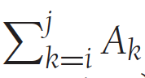
Maximum Subsequence Sum Problem
Given (possibly negative) integers A1, A2, . . . , AN, find the maximum value of
Example:
For input −2, 11, −4, 13, −5, −2, the answer is 20 (A2 through A4).

Slide 22
Let's digest this
What is complexity?

Slide 23
Possible scenarios
If all numbers are positive?
If there are negative numbers?
If all of them are negative numbers?
How does the computation time change for each of the above cases?

Slide 24
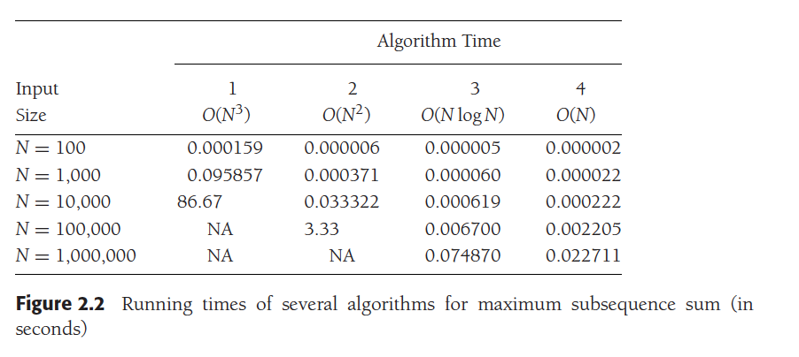
Why is this important?

Slide 25
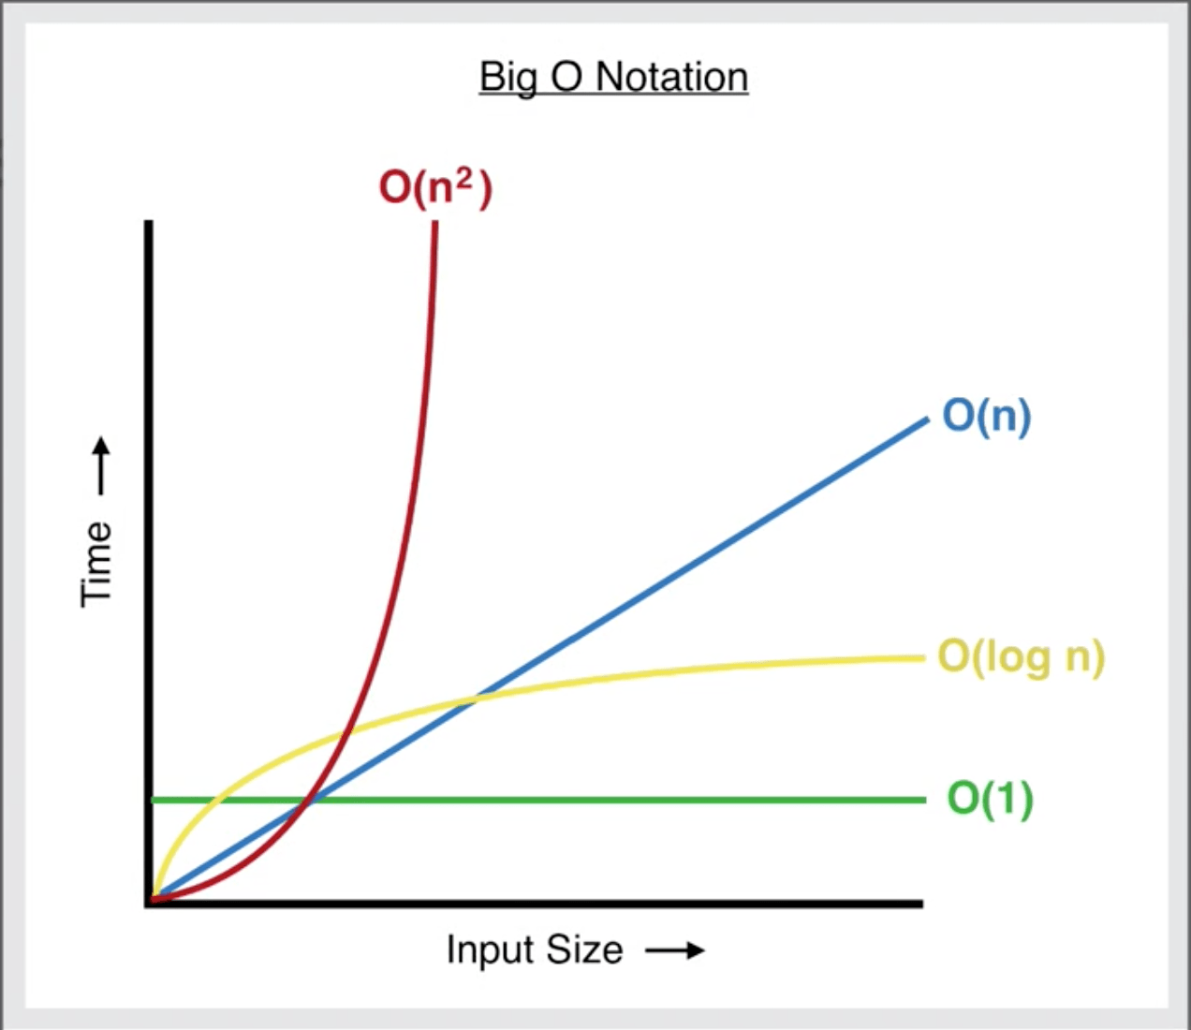
More precisely

Slide 26
Running-Time Calculations
There are several ways
Code, run and compare
Or estimate

Slide 27
A simple program to illustrate
int sum( int n )
{
int partialSum;
1 partialSum = 0;
2 for( int i = 1; i <= n; ++i )
3 partialSum += i * i * i;
4 return partialSum;
}

Slide 28
How do we calculate the run time cost?
The analysis of this fragment is simple.
The declarations count for no time.
Lines 1 and 4 count for one unit each.
Line 3 counts for four units per time executed (two multiplications,
one addition, and one assignment) and is executed N times, for a total of 4N units.
Line 2 has the hidden costs of initializing i, testing i ≤ N, and incrementing i. The total cost of all these is 1 to initialize, N+1 for all the tests, and N for all the increments, which is 2N + 2.
We ignore the costs of calling the function and returning, for a total of 6N + 4.
Thus, we say that this function is O(N).

Slide 29
But we do not need a precise answer, we estimate
For instance, line 3 is obviously an O(1) statement (per execution), so it is silly to count precisely whether it is two, three, or four units; it does not matter.
Line 1 is obviously insignificant compared with the for loop, so it is silly to waste time here.
This leads to several general rules.

Slide 30
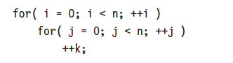
General rules for computing run time
Rule 1—FOR loops
Number of iterations
Rule 2—Nested loops
MxN (Normally N²)

Slide 31
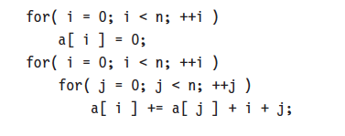
Rule 3—Consecutive Statements
Just add the instructions
This ended up with the max

Slide 32
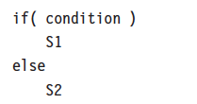
Rule 4—If/Else
the running time of an if/else statement is never more than the running time of the test plus the larger of the running times of S1 and S2.

Slide 33
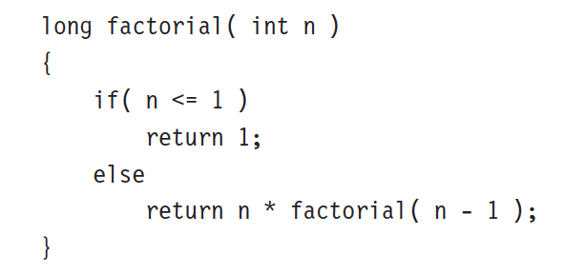
Function calls – recursive functions
This is a simple for loop

Slide 34
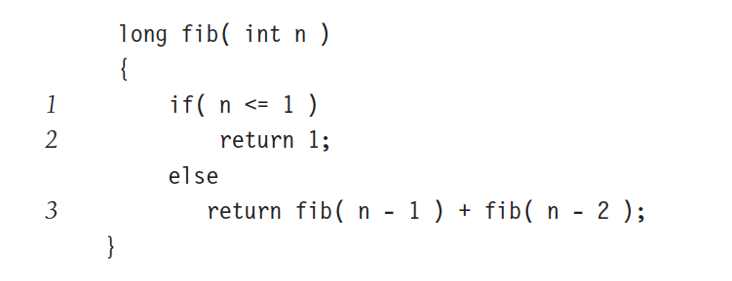
Bad recursive function
This recursion is bad. Why?

Slide 35
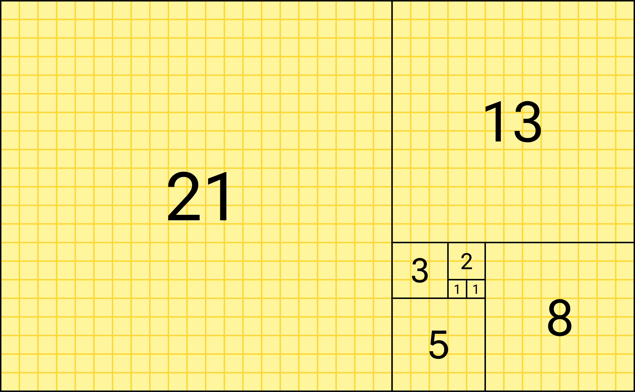
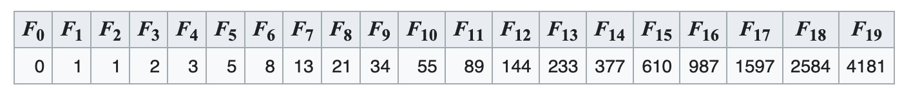
Analysis is simple
T(N) is the time complexity of Fib(N) then
T(N) = T(N − 1) + T(N − 2) + 2

Slide 36
Terrible time complexity
Fib(10) = 89
Time taken for n=10: 0.00s
Fib(50) = 20365011074
Time taken for n=20: 70.39s
Fibonacci series has exponential time complexity

Slide 37
Algorithm demonstration
Fibonacci

Slide 38
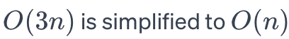
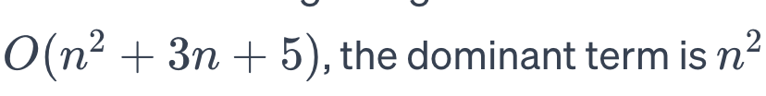
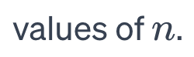
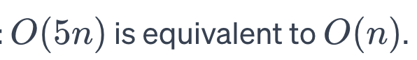
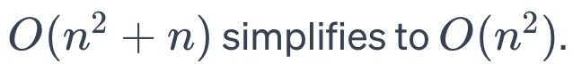
Big O notation rules
Constant Multiplicative Factors are Omitted
Dominant Terms Matter
Addition of Terms
Multiplicative Factors
Drop Lower-Order Terms

Slide 39
Let’s take Maximum Subsequence Sum Problem
Given (possibly negative) integers A1, A2, . . . , AN, find the maximum value of
Example:
For input −2, 11, −4, 13, −5, −2, the answer is 20 (A2 through A4).

Slide 40
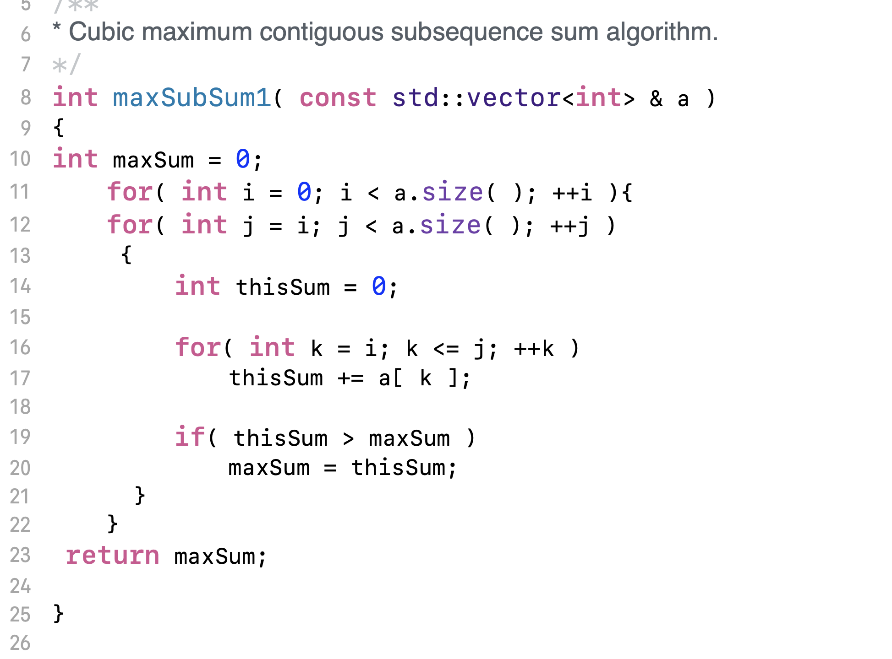
O(N³) Version

Slide 41
Run time
Time taken for 1000 items: 0 seconds
Time taken for 3000 items: 9 seconds

Slide 42
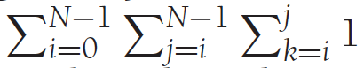
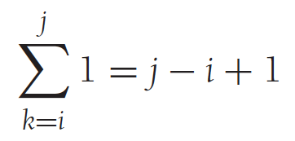
Let’s analyze the algorithm
This has three loops
Let’s work inside out

Slide 43
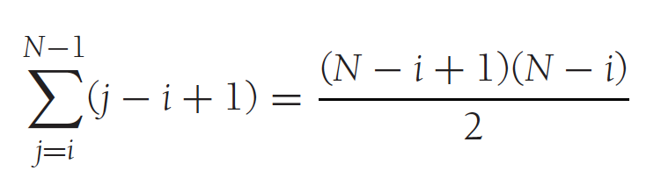
Next outer loop

Slide 44
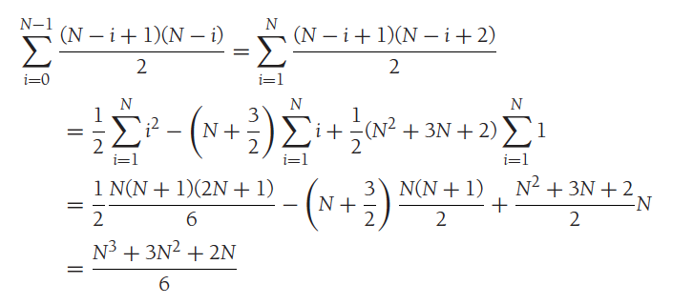
Finally, the outer most loop

Slide 45
By Now
You should understand the importance of the algorithm analysis

Slide 46
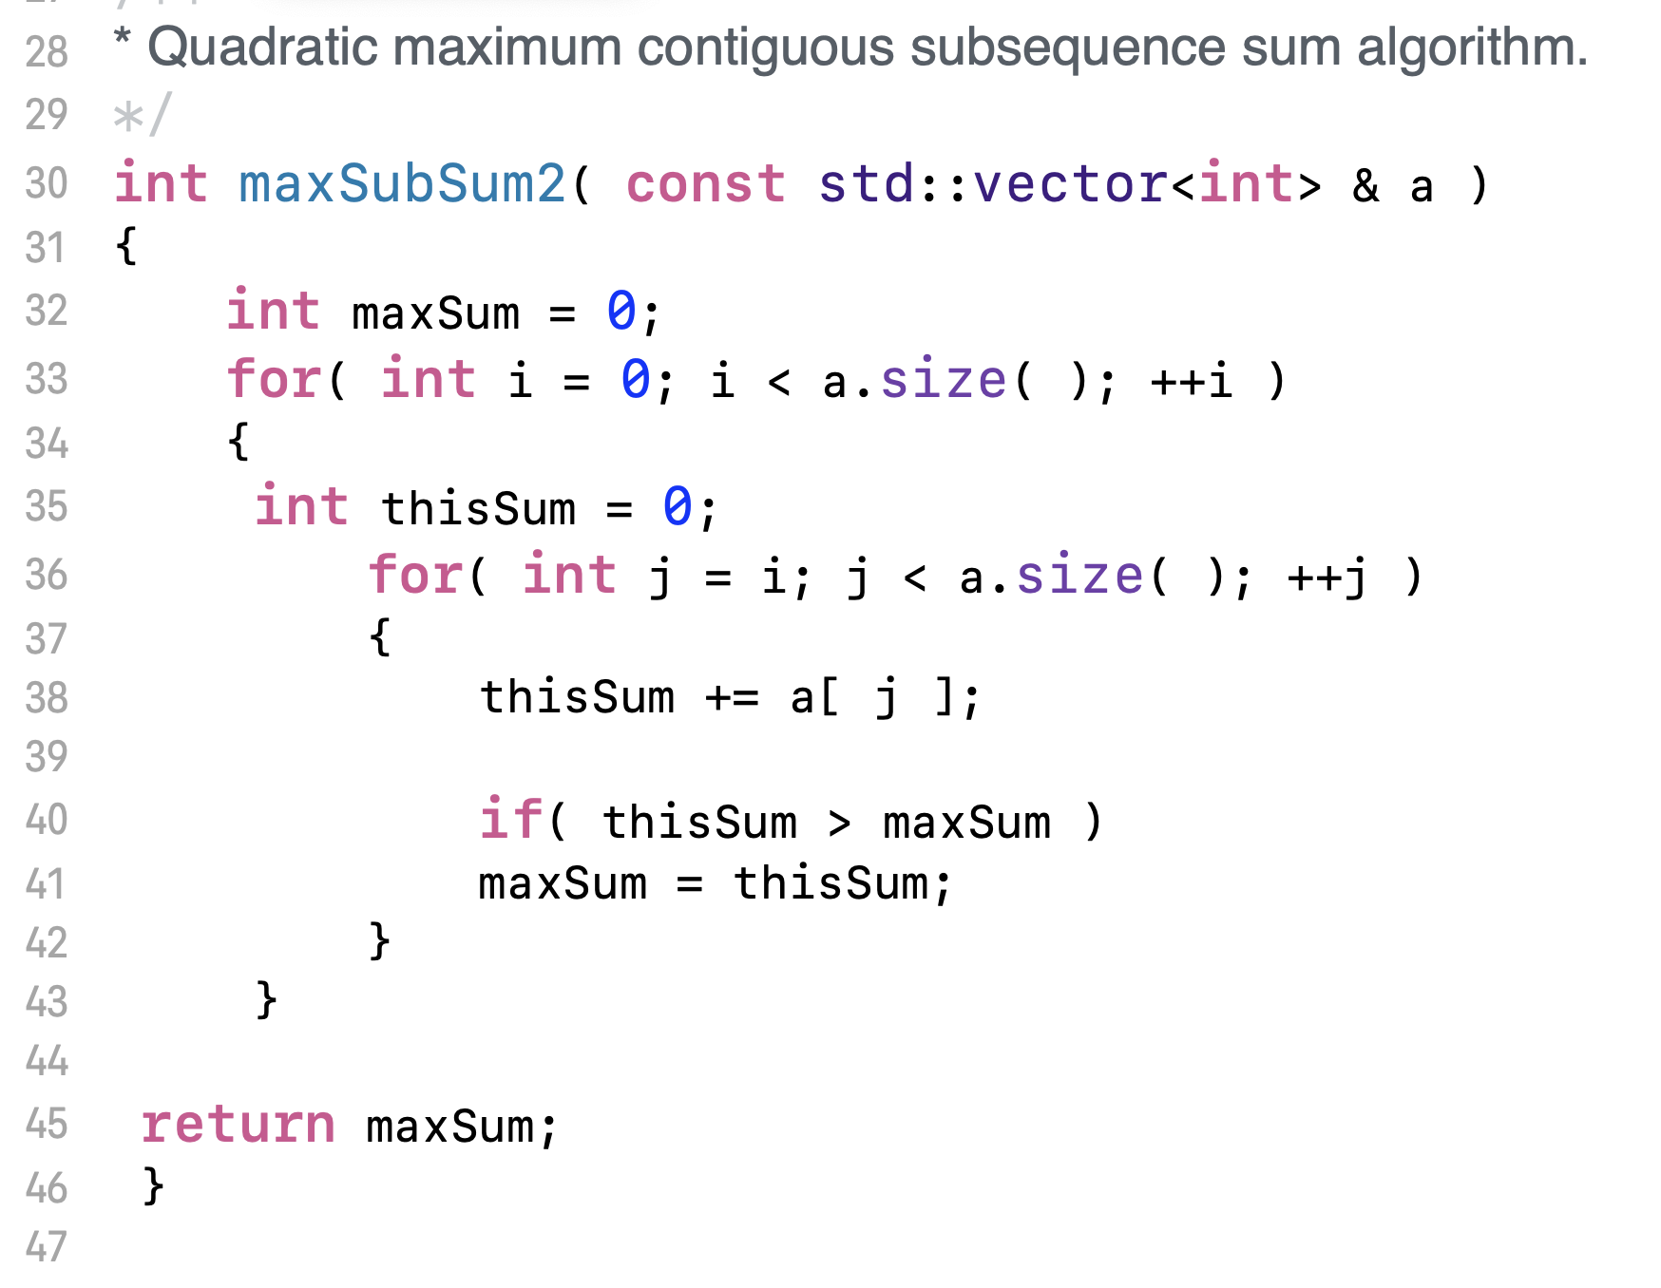
We can improve the Max Sum algorithm
We can remove a loop

Slide 47
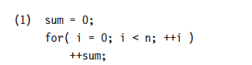
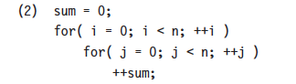
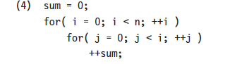
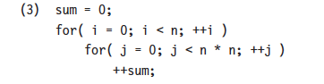
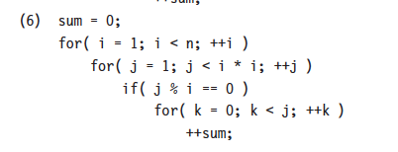
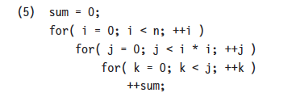
Exercise – Estimate the Big O

Slide 48
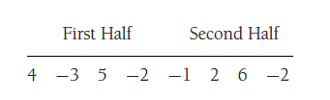
N log N version of Sum of sub array
Divide and conquer
The maximum subsequence sum for the first half is 6 (elements A1 through A3) and for the second half is 8 (elements A6 through A7).

Slide 49
N log N version of Sum of sub array
The maximum sum in the first half that includes the last element in the first half is 4 (elements A1 through A4),
maximum sum in the second half that includes the first element in the second half is 7 (elements A5 through A7).
Thus, the maximum sum that spans both halves and goes through the middle is 4 + 7 = 11 (elements A1 through A7).
We see, then, that among the three ways to form a large maximum subsequence, for
our example, the best way is to include elements from both halves. Thus, the answer is 11.

Slide 50
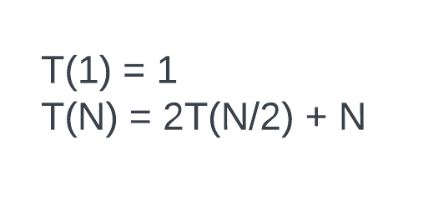
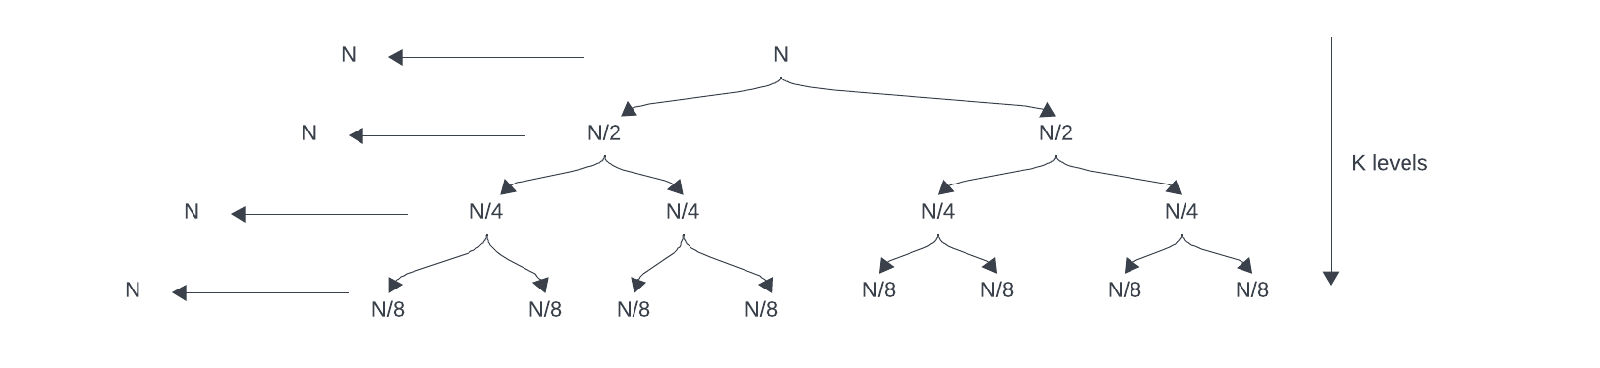
Analysis

Slide 51
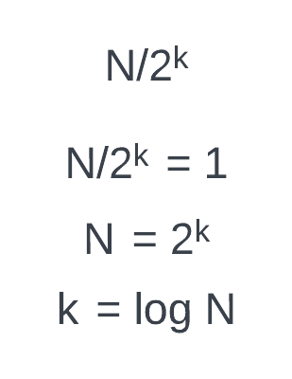
Analysis
Total time it takes = Nk
But K = log N
Total time = N log N

Slide 52
Algorithm demonstration

Slide 53
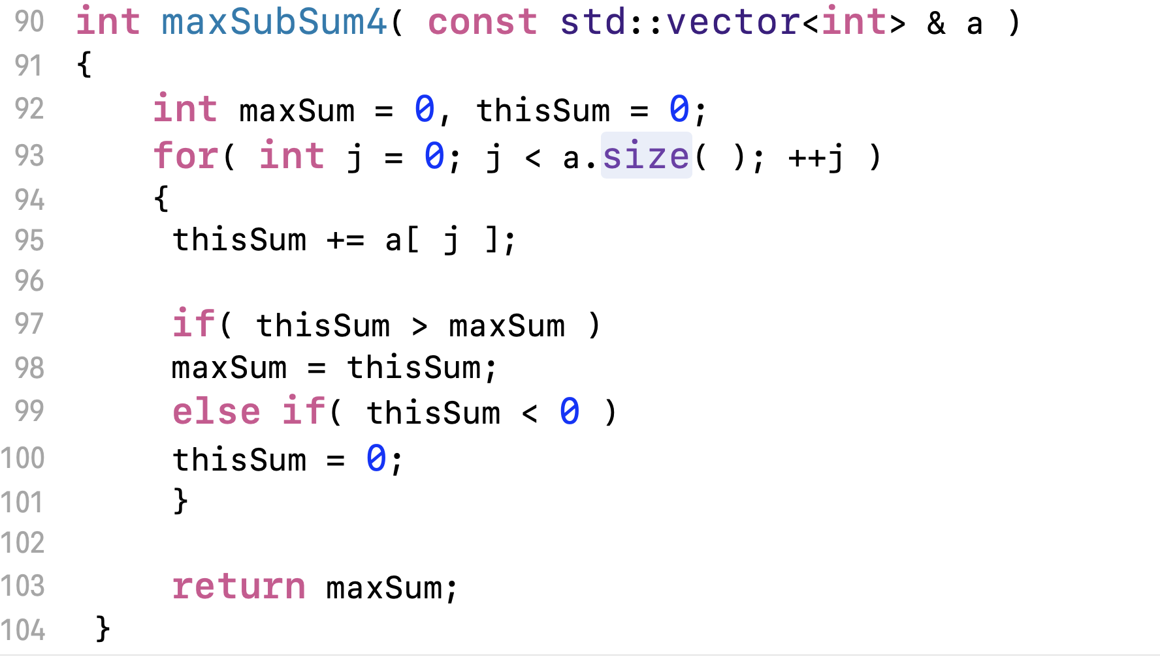
Linear version of the algorithm

Slide 54
Complexity of the algorithm
This algo has only one pass through the data set. It has a linear complexity.

Slide 55
Logarithms in runtimes
An algorithm is O(logN) if it takes constant (O(1)) time to cut the problem size by a fraction (which is usually 12).
if constant time is required to merely reduce the problem by a constant amount (such as to make the problem smaller by 1), then the algorithm is O(N).

Slide 56
How does it become log N
To read a set of data items of size N needs N reads. It is Omega (N)
We ignore the data read time and assume it pre-read the dataset
And compute ethe complexity only for the processing part of the algorithm

Slide 57
Binary search
Given an integer X and integers A0, A1, . . . , AN−1, which are presorted and already in memory, find i such that Ai = X, or return i = −1 if X is not in the input.
The simplest algorithm is to search through the entire list every time we need to search
Can we improve the complexity?

Slide 58
How binary search works
We check the middle element. If it is the right element, we return it.
If X is smaller than the middle element, we can apply the same strategy to the sorted subarray to the left of the middle element
likewise, if X is larger than the middle element, we look to the right half.

Slide 59
Analysis of binary search
inside the loop takes O(1) per iteration
The loop starts with high - low = N − 1 and finishes with high - low ≥ −1.
high - low must be at least halved from its previous value;
thus, the number of times around the loop is at most log(N − 1) + 2.
Example:
if high - low = 128, then the maximum values of high - low after each iteration are 64, 32, 16, 8, 4, 2, 1, 0, −1
Thus, the running time is O(logN).

Slide 60
Exponentiation
Raising an integer to a power (which is also an integer).
X^{Y}
The obvious algorithm to compute XN uses N−1 multiplications.
Any other way of doing it that is much more efficient than this?

Slide 61
Exponentiation problem
if N is even,
we have X^{N} = X^{N/2} X^{N/2}
if N is odd,
X^{N} = X^{(N−1)/2} X^{(N−1)/2} X.
For instance, to compute X⁶², the algorithm does the following calculations, which involve only nine multiplications:

Slide 62
Analysis – recursive version 1
T(N) = T(N-1) + c
T(N) = T(N-2) + 2c
T(N) = T(N-3) + 3c
T(N) = T(N-k) + kc
Let
N – k = 0
k = N
Hence
T(N) = T(0) + Nc
= 1 + Nc
Hence O(N)
Double pow(x,n) {
If (n == 0)
return 1;
Else
return pow(x, n-1) * x;
}

Slide 63
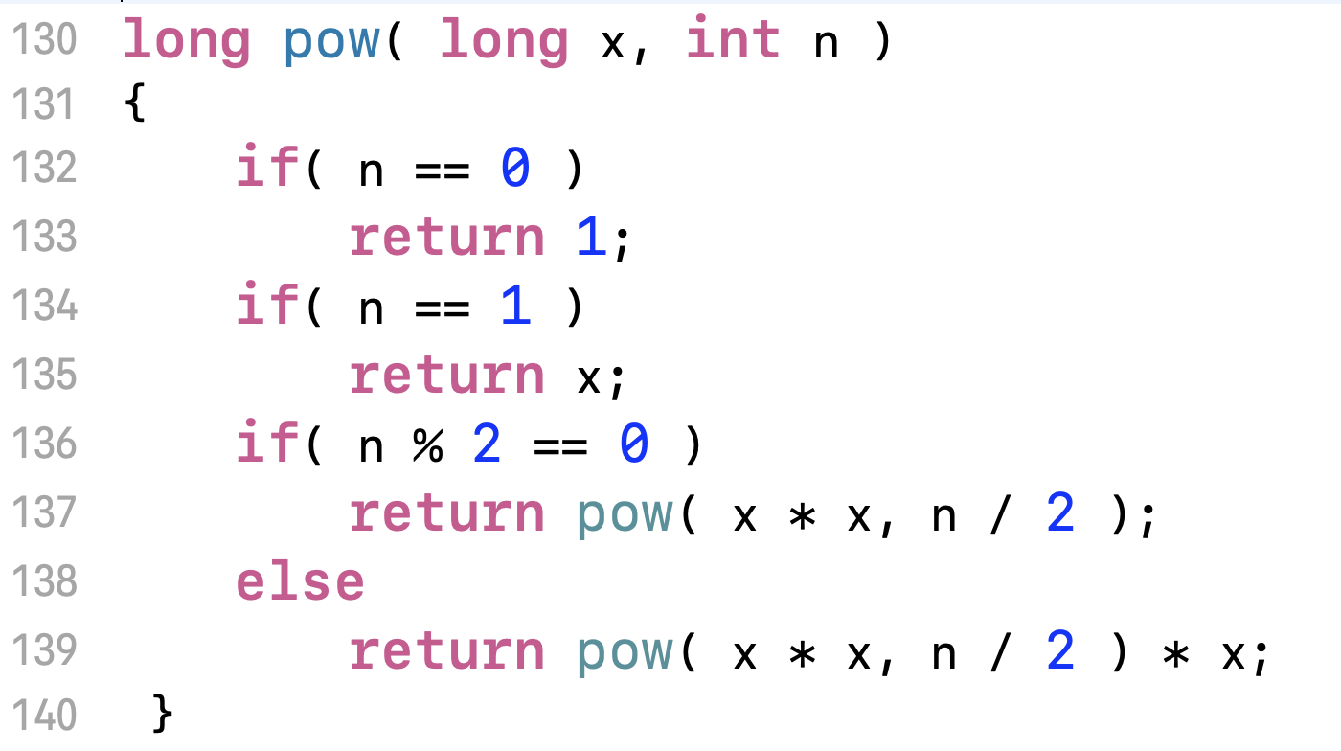
Analysis – recursive version 2 – Class Activity
T(N) = T(N/2) + c1 //Even
T(N) = T(N-1) + c2. //odd
T(0) = 1
Hint: for odd case,
After one multiplication, it becomes even.
So
T(N) = T((N-1)/2) + c3
T(N) = T(N/2) + c3

Slide 64
Exercises
An algorithm takes 0.5 ms for input size 100. How long will it take for input size 500 if the running time is the following (assume low-order terms are negligible)?
a. linear
b. O(N logN)
c. quadratic
d. Cubic
The input is an N by N matrix of numbers that is already in memory. Each individual row is increasing from left to right. Each individual column is increasing from top to bottom. Give an O(N) worst-case algorithm that decides if a number X is in the matrix.

